Slide 1
Introduction to Quantum Computing: From a Layperson to a Programmer in 30 Steps
Hiu-Yung Wong
https://link.springer.com/book/10.1007/978-3-030-98339-0
https://www.amazon.com/Introduction-Quantum-Computing-Layperson-Programmer/dp/3030983382
Playlist: https://www.youtube.com/watch?v=024ICO-Xv7E&list=PLnK6MrIqGXsJfcBdppW3CKJ858zR8P4eP&index=47
https://www.youtube.com/watch?v=cChIt5Gpjjg&list=PLnK6MrIqGXsJfcBdppW3CKJ858zR8P4eP&index=48
https://www.youtube.com/watch?v=Qm9VvdrFGTA&list=PLnK6MrIqGXsJfcBdppW3CKJ858zR8P4eP&index=49
https://www.youtube.com/watch?v=oEr1gucpgsE&list=PLnK6MrIqGXsJfcBdppW3CKJ858zR8P4eP&index=50

Slide 2

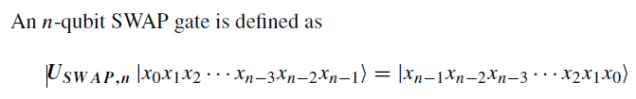
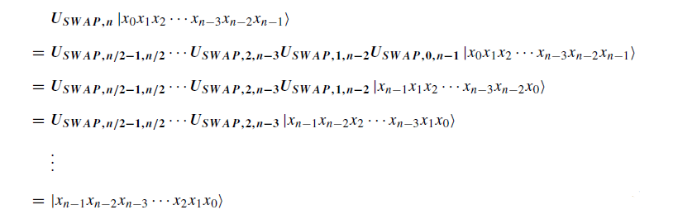
Many-qubit SWAP Gate

Slide 3
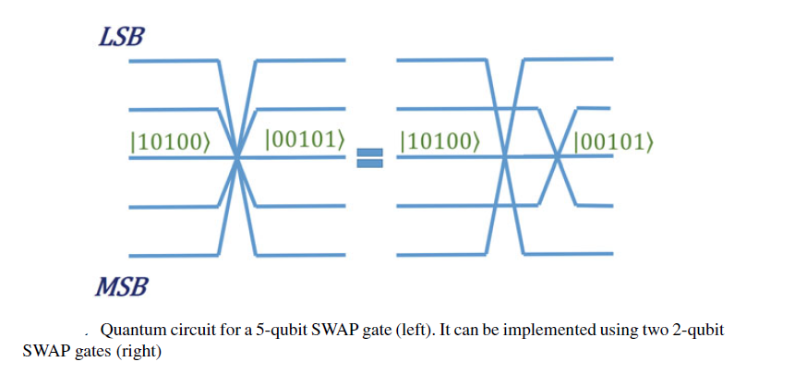
Many-qubit SWAP Gate Circuit

Slide 4

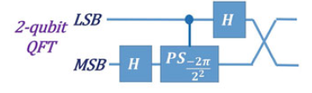
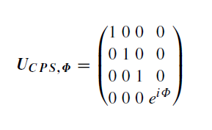
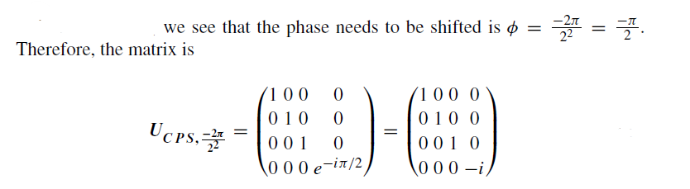
2-qubit QFT Circuit
A 1-qubit QFT circuit is just a Hadamard gate

Slide 5
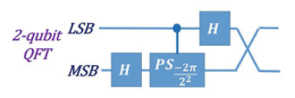
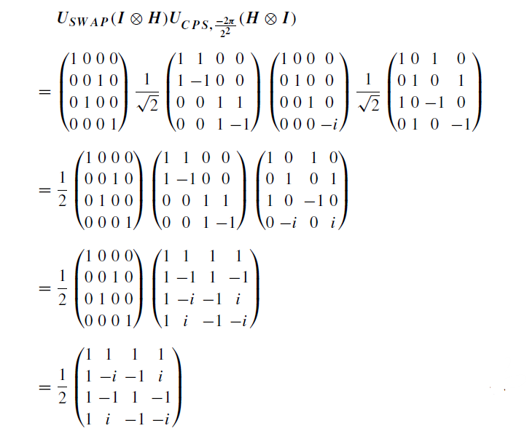
2-qubit QFT Circuit

Slide 6
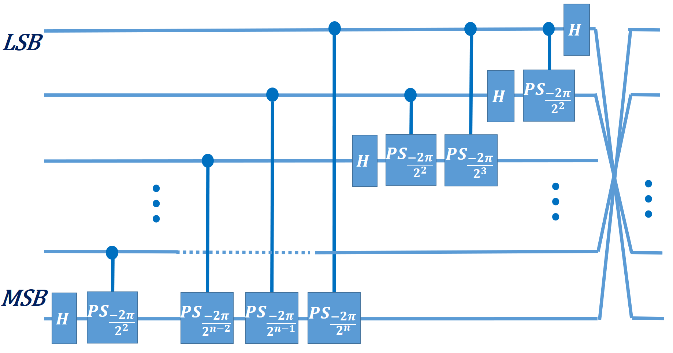
General Circuit for QFT

Slide 7
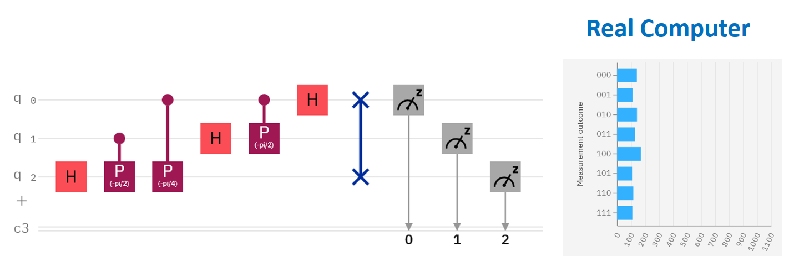
Implementation in IBM-Q (3-qubit)

Slide 8
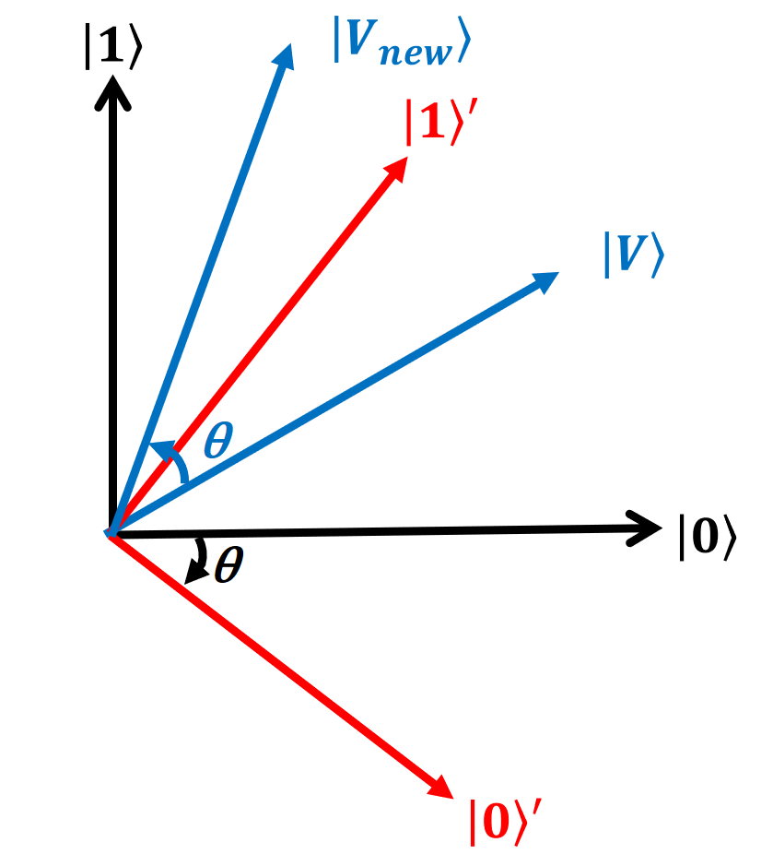
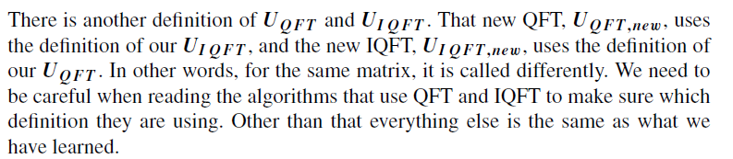
Another Definition of QFT and IQFT

Slide 9
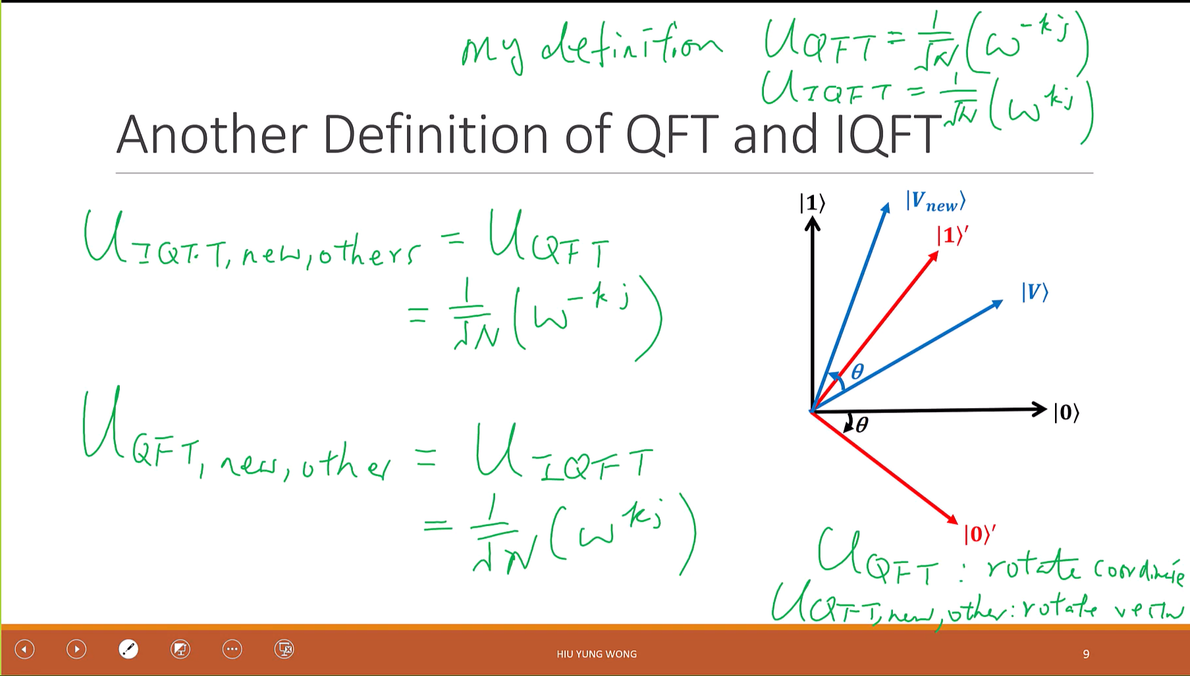

Slide 10
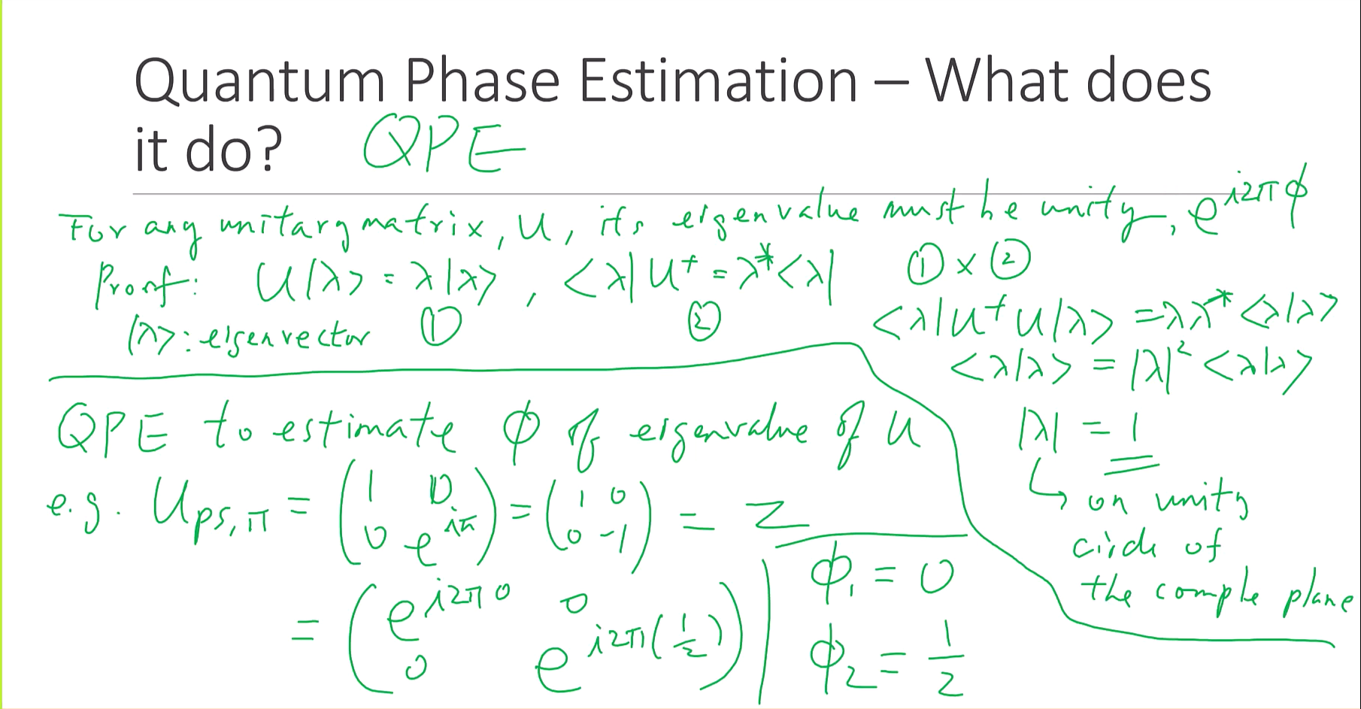

Slide 11


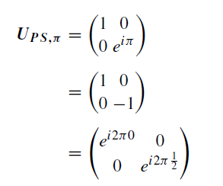


Quantum Phase Estimation – What does it do?

Slide 12
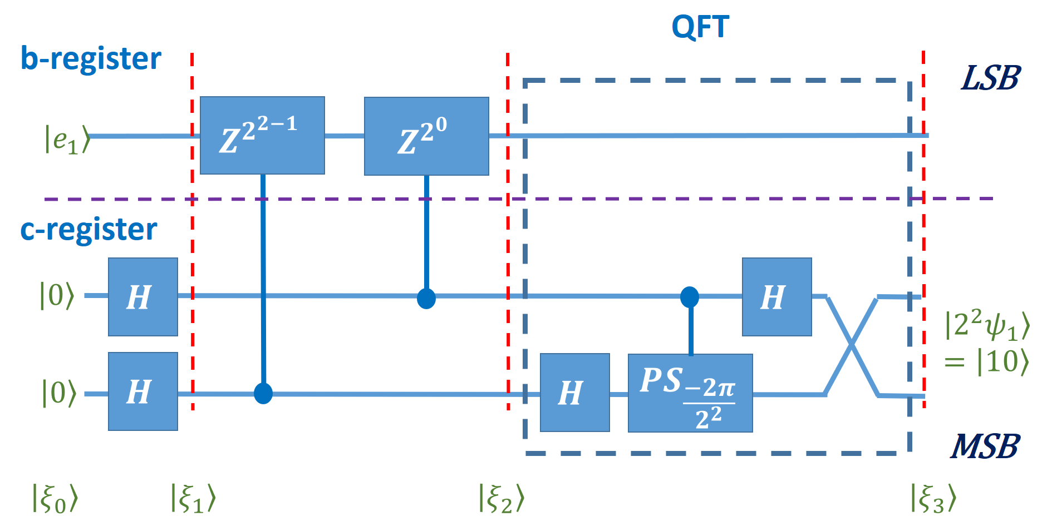
QPE for Z gate

Slide 13


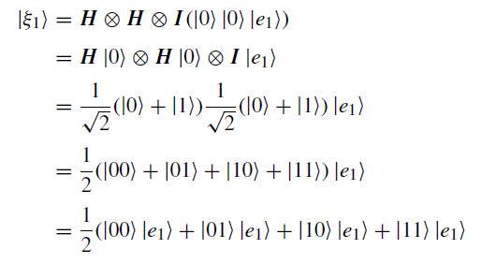

Slide 14
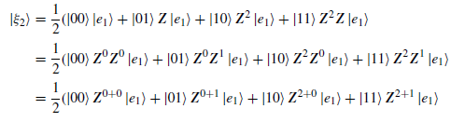
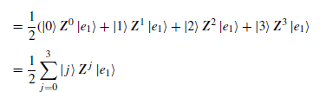
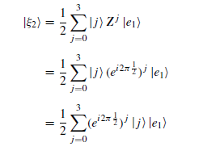

Slide 15
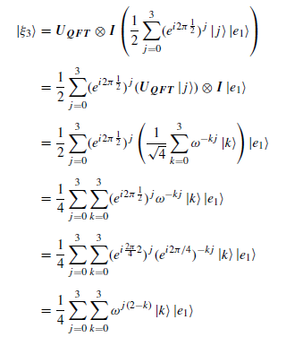
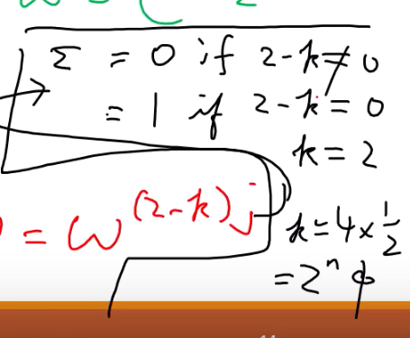


Slide 16
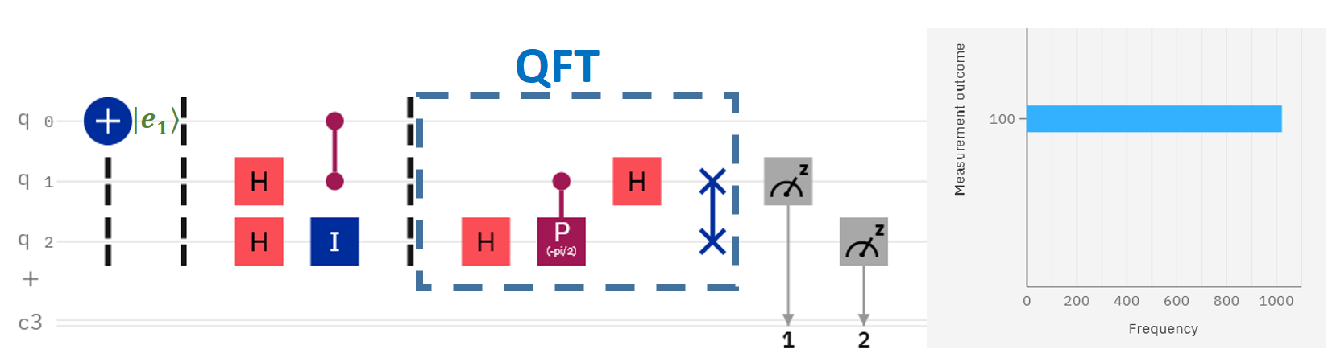
Implementation in Qiskit

Slide 17
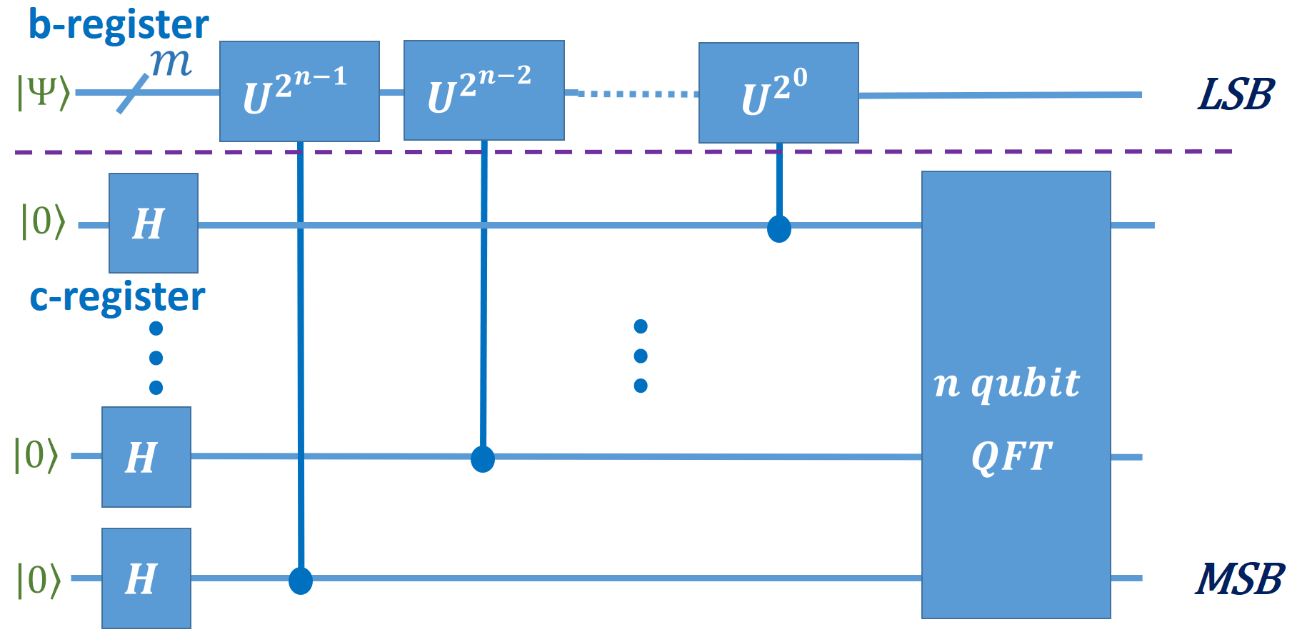
N-qubit QPE Circuit

